Slide 1

ProjectworkPhase1(19AI702) – Review2
Agriculture Chatbot
Submitted by:
Prasanna R (212222040120)
Padmashree R (212222040110)
2022-2026 Batch
TEAM NO: 230
Under the guidance of:
Dr. V. Umarani
Associate Professor
Department of Computer Science and Engineering
SAVEETHA ENGINEERING COLLEGE
(Autonomous Institution – UGC, Govt. of India)
(Affiliated to Anna University, Approved by AICTE - Accredited by NBA & NAAC – ‘A’ Grade - ISO 9001:2015 Certified)
Saveetha Nagar, Thandalam, Chennai-602 105, TamilNadu, INDIA.

Slide 2
Agenda
1.Introduction
2.Statement of the Problem
3.Scope of the Project
4.Methodology
5.Architecture Diagram
6.Design
7.Implementation
8.Output
9.Test Cases
10.Conclusion
11.Future Work

Slide 3
Introduction
What is an Agriculture Chatbot?
An AI-powered conversational agent designed to provide farmers with instant, interactive, and personalized agricultural advice.
It uses Natural Language Processing (NLP) to understand farmer queries in text or voice (multi-lingual support is a key feature).
The bot acts as a first-level advisory service, offering suggestions for crop selection, pest and disease identification, and best practices.

Slide 4
Statement of the Problem
Information Gap and Timeliness
Delayed Diagnosis: Farmers often have to wait for agricultural extension officers, delaying the diagnosis and treatment of crop diseases or pest infestations.
Expert Scarcity: Access to agricultural experts is limited, especially for small-scale farmers in developing regions.
Language Barrier: Information is often available only in major languages, excluding many regional farmers.
Inconsistent Data: Advice found online can be generic, non-contextual, and unreliable

Slide 5
Scope of the project
Data Collection: Gathering a knowledge base of crop data, pest symptoms, fertilizer requirements, and climate information.
Model Development: Building a Sequence-to-Sequence (Seq2Seq) or transformer-based NLP model for question-answering.
Contextual Understanding: Integrating location and crop type to provide personalized advice.
User Interface: Developing a user-friendly web/mobile interface using the MERN stack for deploying the chatbot.

Slide 6
Scope of the project
Pneumonia Prediction
  Inclusions:
  Data Collection
  Model Development
  Contextual Understanding
  User Interface:
  Exclusions:
  The project will not include direct control over farming equipment or machinery.
  The current version may not cover all minor, highly specialized crops.

Slide 7
Scope of the project
Pneumonia Prediction
  Data:
  A trained and evaluated NLP Chatbot Model.
  A user-friendly MERN Stack Portal for farmers to interact with the bot.
  Documentation detailing the knowledge base, model architecture, and performance.

Slide 8
Methodology
Methodology of diagnosing pneumonia is using machine learning and portal using MERN stack
Data Collection & Knowledge Base Creation:
Curate a comprehensive dataset of agricultural questions and expert answers (Q&A pairs).
Gather crop-specific data (diseases, pests, nutrient requirements).
Data Preprocessing:
Tokenization, stemming, and stop-word removal for text data.
Data augmentation to cover various phrasing of farmer queries.
NLP Model Development (Seq2Seq/Transformer):
Develop a deep learning model capable of mapping farmer queries (input sequence) to relevant expert answers (output sequence).
Train and optimize the model using techniques like hyperparameter tuning.

Slide 9
Methodology
Web Portal Development (MERN Stack):
Build the frontend (React) and backend (Node.js/Express) for the chatbot interface.
Use MongoDB to store user interactions and the knowledge base.
Integration and Testing:
Integrate the trained NLP model with the MERN application.
Test the system extensively for accuracy, response time, and reliability in answering diverse farmer queries.

Slide 10
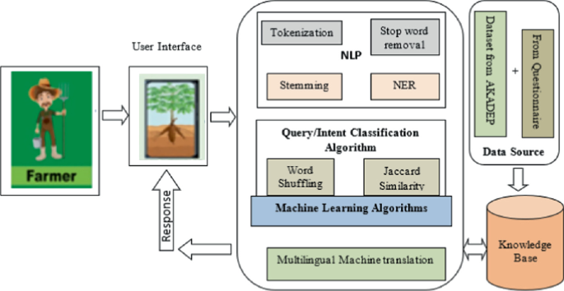
Architecture Diagram/Flow

Slide 11
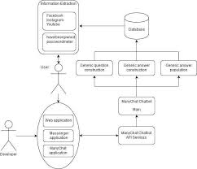
Design-Use Case Diagram
UML DIAGRAMS
Use case Diagram:A use case diagram is a graph of actors set of use cases enclosed by a system boundary, communication associations between the actors and users and generalization among use cases.
The use casee model defines the outside (actors) and inside (use case) of the system’s behavior.
USER

Slide 12
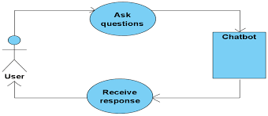
Design-Use Case Diagram
UML DIAGRAMS
ADMIN

Slide 13
Design-Class Diagram
Class Diagram:A class is a representation of an object and, in many ways; it is simply a template from which objects are created. Classes form the main building blocks of an object-oriented application.
Although thousands of students attend the university, you would only model one class, called Student, which would represent the represent the entire collection of students.

Slide 14
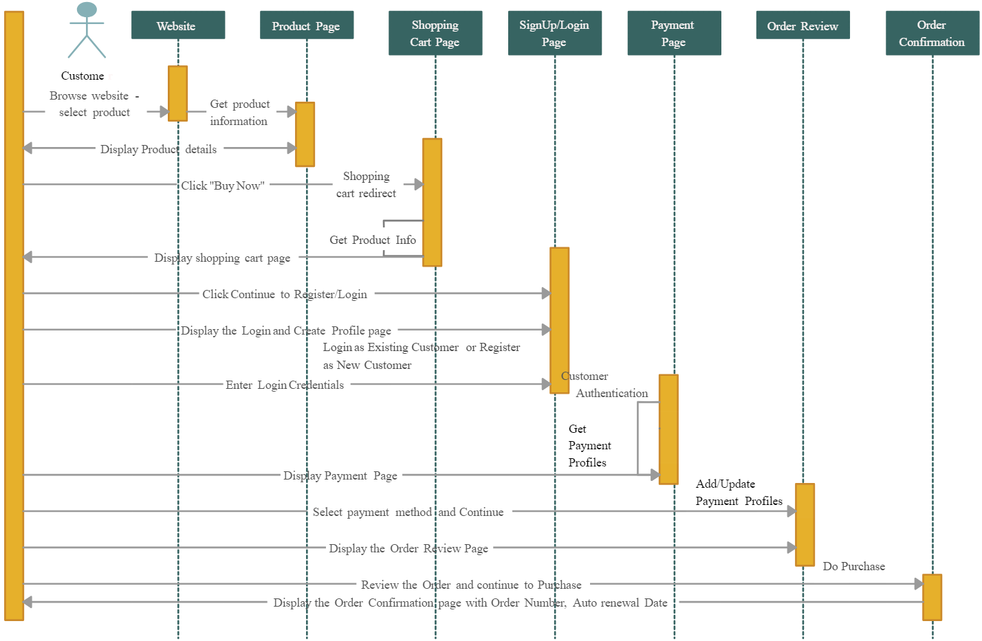
Sequence Diagram - ecommerce example

Slide 15
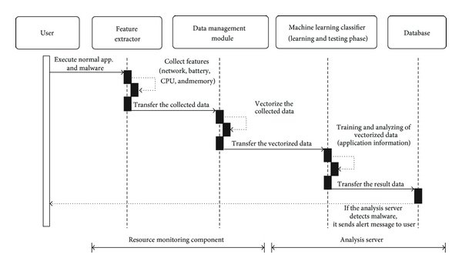
Sequence Diagram

Slide 16
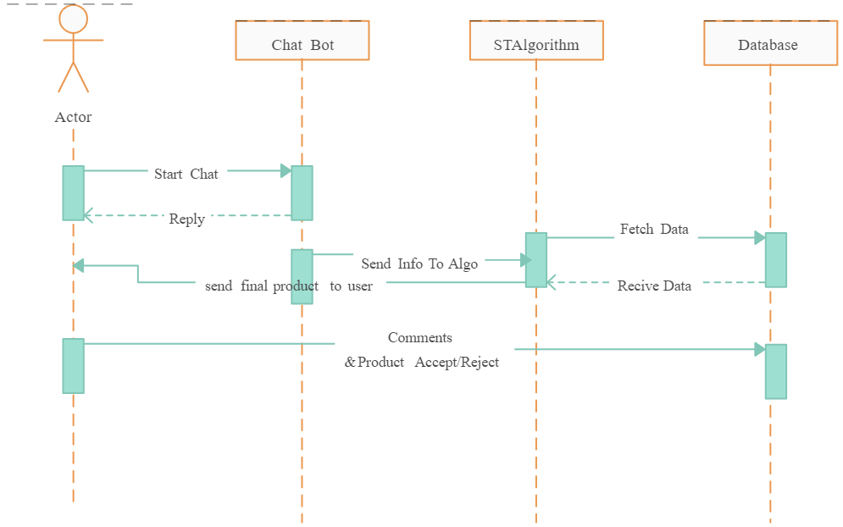
Sequence Diagram

Slide 17
Algorithms used
1. Transformer Network (or similar Deep Learning NLP Model)
The core model for the chatbot's Sequence-to-Sequence (Seq2Seq) task.
Purpose: To process the natural language input (farmer's question) and generate the most relevant, context-specific, and accurate natural language response (advice).

Slide 18
Algorithms used
The project uses following Algorithms:
Margin-based Embedding Model:
  A Margin-based Embedding Model for Predicting Early Reviewers. Our model
  Can characterize both user comparison relations and the information from the Product side. Hence, it is expected to give better performance than the baseline Methods.
  Example: User Reviews are combined with product description i.e. if a user has given positive review for Kurtas and mentions about quality of cloth then product descriptions which has good quality of cloth and of type kurtas are most likely to be bought by the user.

Slide 19
Hardware and software selection
Sensors
  Winsen ZH07 dust and particulate matter sensor.
  MQ7 – Smoke(CarbonMonoxide)
  MQ2 – LPG
  DGT11 – Temperature & Humidity
  MQ135 – Other harmful gases like NH3, S, C6H6, CO2.. Etc)
All pollutant
  CarbonMonoxide(Smoke)
  LPG
  NH3, S, C6H6, CO2,
  Oxygen Level
Iot enabled microcontroller node mcu
Iot platform –ThingSpeak

Slide 20
Implementation
The project is implemented by python using the following libraries:
  OpenCV
  PyTorch
The project includes python scripts that can be used to detect an image files.
From Google Drive we are uploading the yolov7 model and the dataset.
We train the model using YOLOv7.
The YOLOv7 model detects the obstacle or the object present in image.
The obstacle is categorized into one of the various classes which are labelled in the dataset.
It will display the bounding box as the output along with its class name.

Slide 21
Important Code segments
INPUT DATASET
import streamlit as st
from PyPDF2 import PdfReader
from langchain_text_splitters import RecursiveCharacterTextSplitter
from langchain_community.embeddings import HuggingFaceEmbeddings
from langchain_community.vectorstores.faiss import FAISS
from langchain_google_genai import ChatGoogleGenerativeAI
from langchain_core.prompts import PromptTemplate
from langchain_core.output_parsers import StrOutputParser
import os
from dotenv import load_dotenv
# ---------------------------
# ENV SETUP
# ---------------------------
load_dotenv()
st.set_page_config(page_title="Document Genie", layout="wide")
api_key = os.getenv("GOOGLE_API_KEY")
if not api_key:
st.error("Google API Key missing. Add it in .env file")
st.stop()
# ---------------------------
# GLOBAL EMBEDDINGS (IMPORTANT)
# ---------------------------
embeddings = HuggingFaceEmbeddings(
model_name="sentence-transformers/all-MiniLM-L6-v2"
)
# ---------------------------
# PDF TEXT EXTRACTION
# ---------------------------
def get_pdf_text(pdf_docs):
text = ""
for pdf in pdf_docs:
pdf_reader = PdfReader(pdf)
for page in pdf_reader.pages:
text += page.extract_text() or ""
return text

Slide 22
Important Code segments
# ---------------------------
# SPLIT TEXT
# ---------------------------
def get_text_chunks(text):
splitter = RecursiveCharacterTextSplitter(
chunk_size=10000,
chunk_overlap=1000
)
return splitter.split_text(text)
# ---------------------------
# VECTOR STORE (FAISS)
# ---------------------------
def get_vector_store(text_chunks):
vector_store = FAISS.from_texts(
text_chunks,
embedding=embeddings
)
vector_store.save_local("faiss_index")

Slide 23
Important Code segments
# ---------------------------
# QA CHAIN (GEMINI ONLY FOR CHAT)
# ---------------------------
def get_conversational_chain():
prompt_template = """
Answer the question using ONLY the provided context.
If the answer is not found in the context, reply:
"Answer is not available in the context."
Context:
{context}
Question:
{question}
Answer:
"""
model = ChatGoogleGenerativeAI(
model="gemini-pro",
temperature=0.3,
google_api_key=api_key
)
prompt = PromptTemplate(
template=prompt_template,
input_variables=["context", "question"]
)
chain = prompt | model | StrOutputParser()
return chain

Slide 24
Important Code segments
# ---------------------------
# USER QUESTION HANDLER
# ---------------------------
def user_input(user_question):
if not os.path.exists("faiss_index"):
st.warning("Please upload and process PDFs first.")
return
db = FAISS.load_local(
"faiss_index",
embeddings,
allow_dangerous_deserialization=True
)
docs = db.similarity_search(user_question)
if not docs:
st.write("No relevant information found.")
return
chain = get_conversational_chain()
context = "\n\n".join(doc.page_content for doc in docs)
response = chain.invoke({
"context": context,
"question": user_question
})
st.write("### 🤖 Reply")
st.write(response)

Slide 25
Important Code segments
# ---------------------------
# STREAMLIT UI
# ---------------------------
def main():
st.header("🌾 Agriculture AI Chatbot")
user_question = st.text_input(
"Ask a question based on uploaded PDF files:"
)
if user_question:
user_input(user_question)
with st.sidebar:
st.title("📂 Menu")
pdf_docs = st.file_uploader(
"Upload PDF Files",
accept_multiple_files=True
)
if st.button("Submit & Process"):
if not pdf_docs:
st.warning("Please upload at least one PDF.")
return

Slide 26
Important Code segments
with st.spinner("Processing PDFs..."):
raw_text = get_pdf_text(pdf_docs)
if not raw_text.strip():
st.warning("No readable text found in PDFs.")
return
chunks = get_text_chunks(raw_text)
get_vector_store(chunks)
st.success("PDFs processed successfully!")
if __name__ == "__main__":
main()

Slide 27
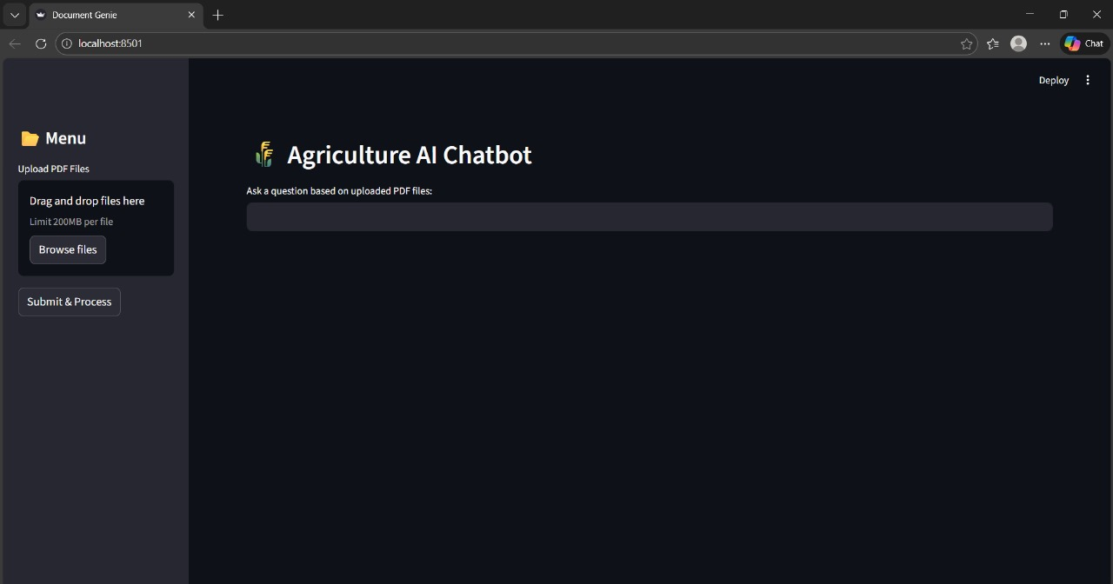
Output
OUTPUT:
After browsing our website, the Agriculture AI Chatbot homepage will be displayed first. This page allows users to upload PDF documents related to agriculture by using the drag-and-drop option or by browsing files from the system. Once the documents are uploaded, the user can submit and process them for analysis. The system enables users to ask questions based on the uploaded PDF files, and the chatbot provides relevant answers using artificial intelligence. This interface ensures easy interaction and efficient information retrieval for users.

Slide 28
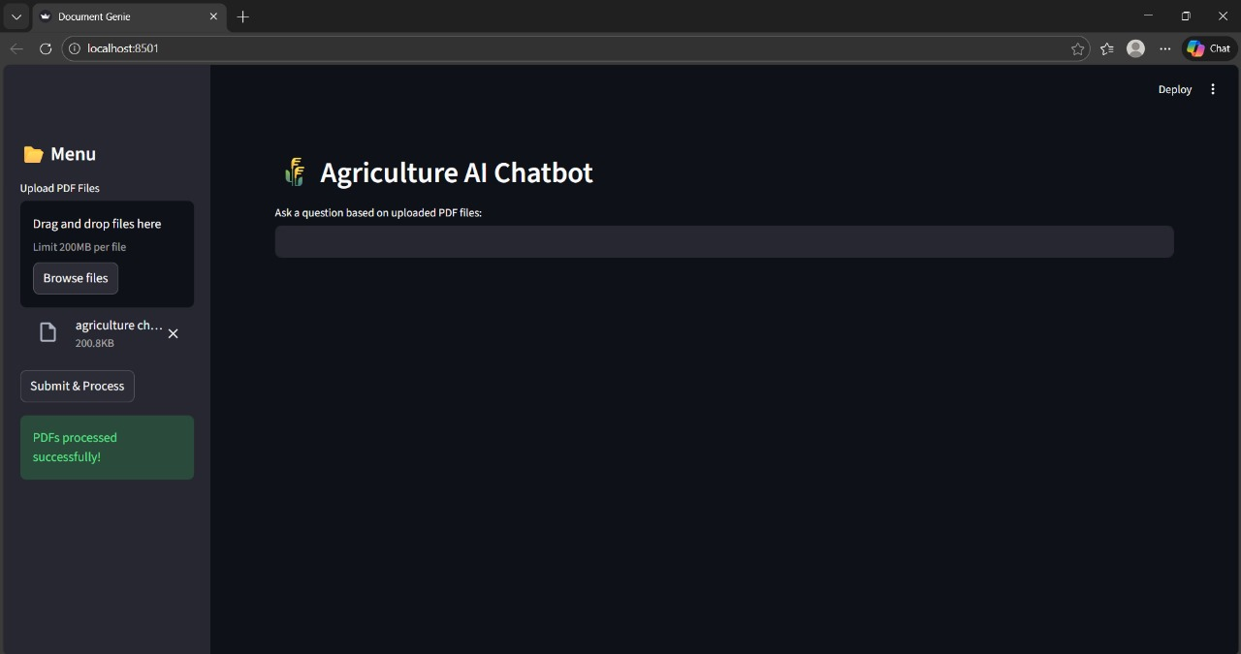
Output
OUTPUT:
After logging in to the website, the Agriculture AI Chatbot dashboard will be displayed to the user. This page allows the user to upload agriculture-related PDF documents using the drag-and-drop option or by browsing files from the system. Once the files are uploaded, the user can submit and process the documents successfully. After processing, the user can ask questions based on the uploaded PDF files, and the chatbot will generate accurate and relevant responses using artificial intelligence, enabling efficient information retrieval.

Slide 29
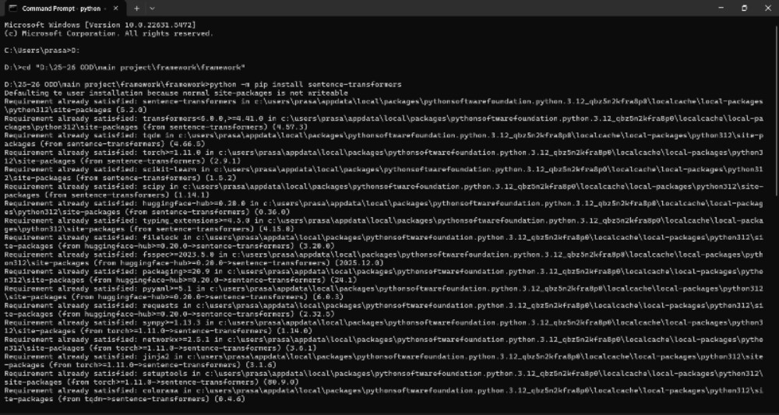
Output
OUTPUT:
If the user wants to set up the required environment for the application, he/she needs to install the necessary Python libraries. The above screen shows the successful installation of the sentence-transformers package using the command prompt. This step ensures that all required dependencies are available for processing documents and generating intelligent responses in the Agriculture AI Chatbot system.

Slide 30
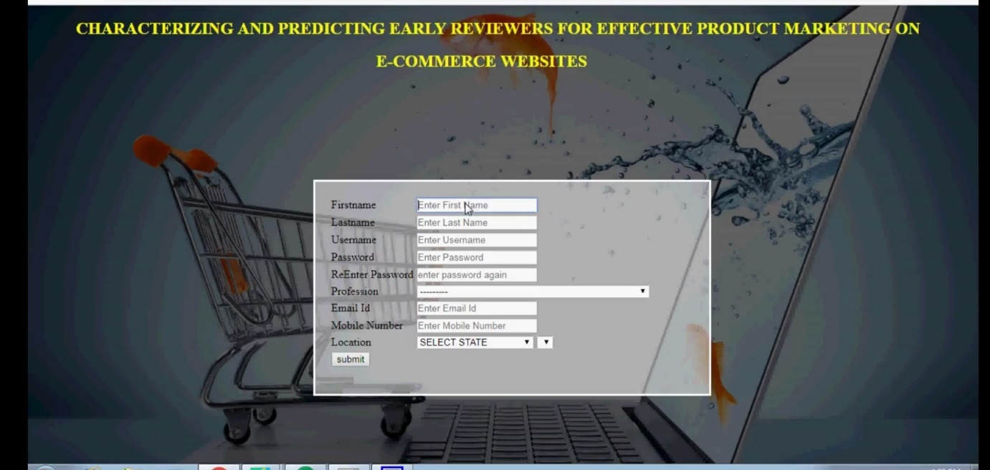
Output
OUTPUT:
The person needs to enter following details for the registration process.
Registration Page

Slide 31
Test Cases
Test Cases
S.NO | Action | Input | Expected output | Actual output | Test Result
1 | Test Case 1: User Registration | Input: New user details (username, email, password). | Expected Output: User account is created successfully, and a confirmation message is displayed. | Actual Output: [To be filled after testing] | Result: Pass/Fail
2 | Test Case 2: User Login | Input: Registered user’s login details (email, password). | Expected Output: User is successfully logged in and redirected to the dashboard. | Actual Output: [To be filled after testing] | Result: Pass/Fail
3 | Test Case 3: Image Upload | Input: X-ray image file uploaded by the user. | Expected Output: Image is uploaded successfully, and a progress bar is displayed. | Actual Output: [To be filled after testing] | Result: Pass/Fail
4 | Test Case 4: Prediction Result Display | Input: Uploaded X-ray image. | Expected Output: Model processes the image, and the prediction result is displayed on the user’s dashboard. | Actual Output: [To be filled after testing] | Result: Pass/Fail
5 | Test Case 5: View Prediction History | Input: Logged-in user navigates to the prediction history page. | Expected Output: List of all previous predictions with dates and results is displayed. | Actual Output: [To be filled after testing] | Result: Pass/Fail

Slide 32
Test Cases
Test Cases (for ecommerce type of projects)
S.NO | Action | Input | Expected output | Actual output | Test Result
1 | The admin uploads product into the website | Product details | The added product should be visible to the customer | The added product should be visible to the customer | Pass
2 | Customer search for product | Product name in the search bar | The respective product should be shown to the user | The product will be available in the list shown to the user | Pass
3 | User gives review to the product | Comment on the product | The comment will be visible in the comment section to all the users | The given comment is not visible because the person did not register in the website | Fail
4 | The user gets the overall review of the product | This is a very good product | Positive | Positive | Pass
5 | User buys the product | Adds the product to the cart and buys the product | The product will be bought by the user | User will get the error because of not log in to the website | Fail

Slide 33
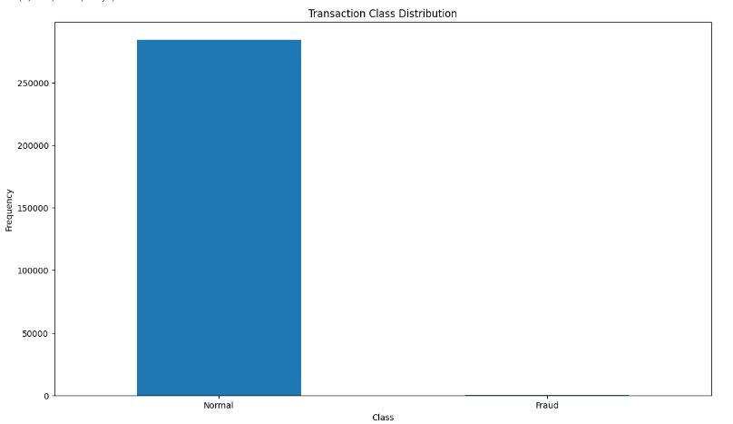
Results
Machine learning
  Accuracy: 90%
  Precision: 93%
  Recall: 92%
  Inferences: Effective predictions, faster diagnosis.

Slide 34
Conclusion
In this Project, our experiments indicate that early reviewer’s ratings and their received helpfulness scores are likely to influence product popularity at a later stage.
So, in these we are using margin based embedding ranking model (MERM) and NLP algorithm for predicting early reviewers in E-Commerce websites. Then the user will instantly get accurate information about the product.

Slide 35
Future Work
In our current work, the review content is not considered. In the future, we will explore effective ways in incorporating review content into our early reviewer prediction model.
We will investigate other sources of in which social networks can be extracted and carry out more insightful analysis.

Slide 36
References
Website Reference:
https://en.wikipedia.org/wiki/Object-modeling_technique
Book / Paper Reference:
K. F. Victor and I. Z. Michael, “Intelligent data analysis and machine learning: Are they really equivalent Concepts?”, 2017 Second Russia and Pacific Conference on Computer Technology and Applications (RPC), 2017, pp. 59–63.
Github link of project
Video link of project demo

Slide 37

Questions

Slide 38


